Slide 1


Space Rover Community
Progress Presentation #2

Slide 2
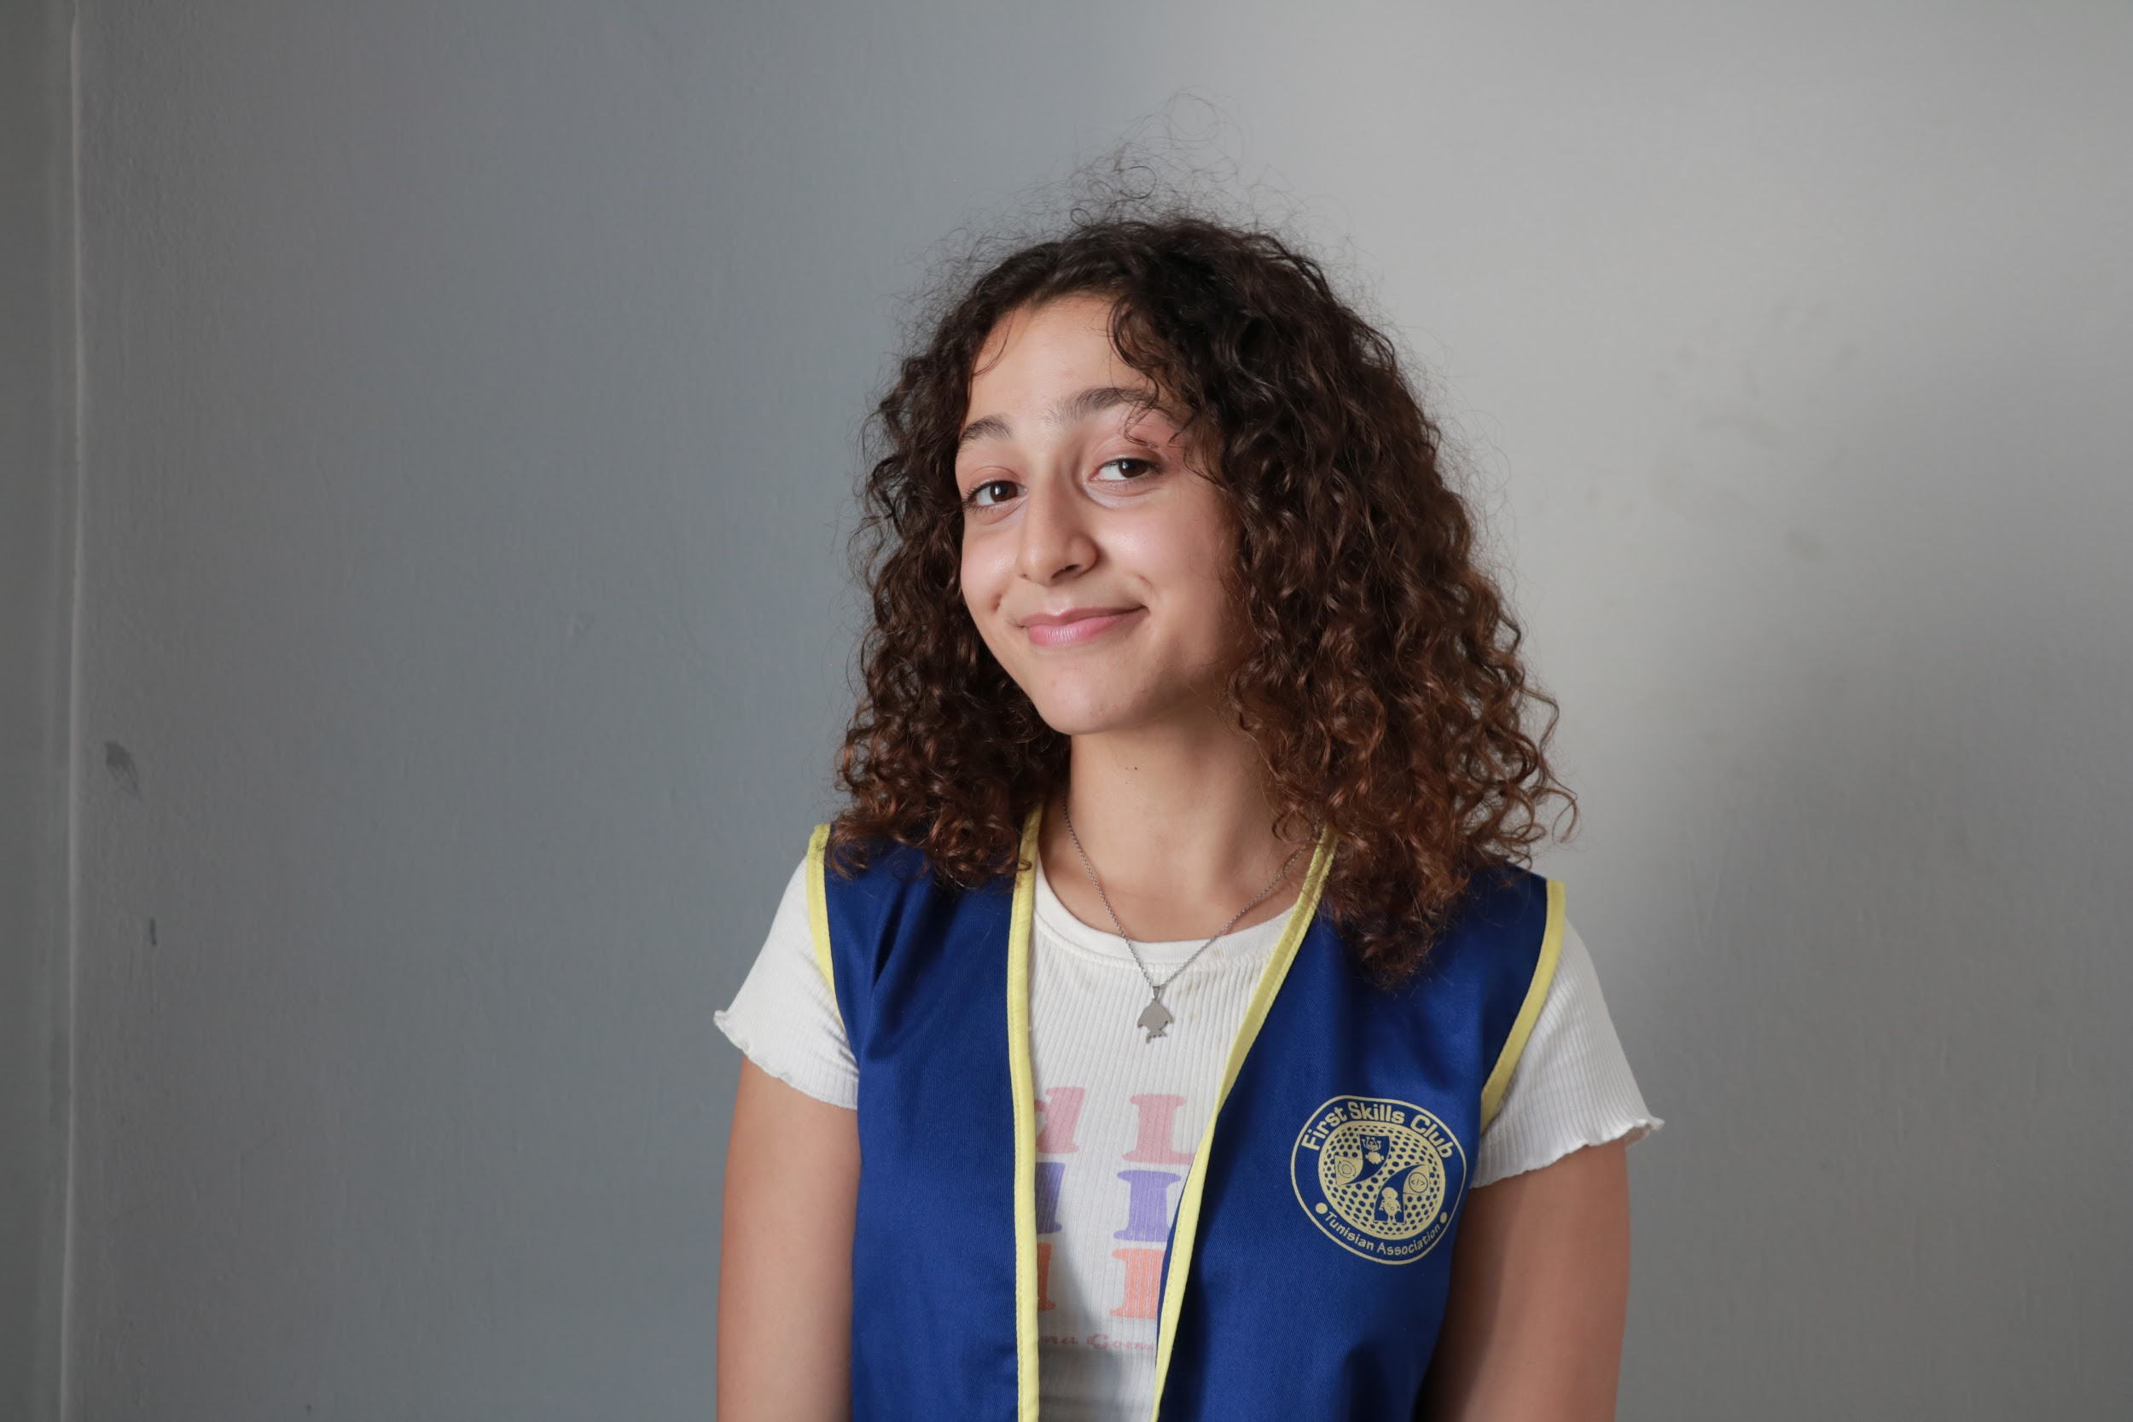
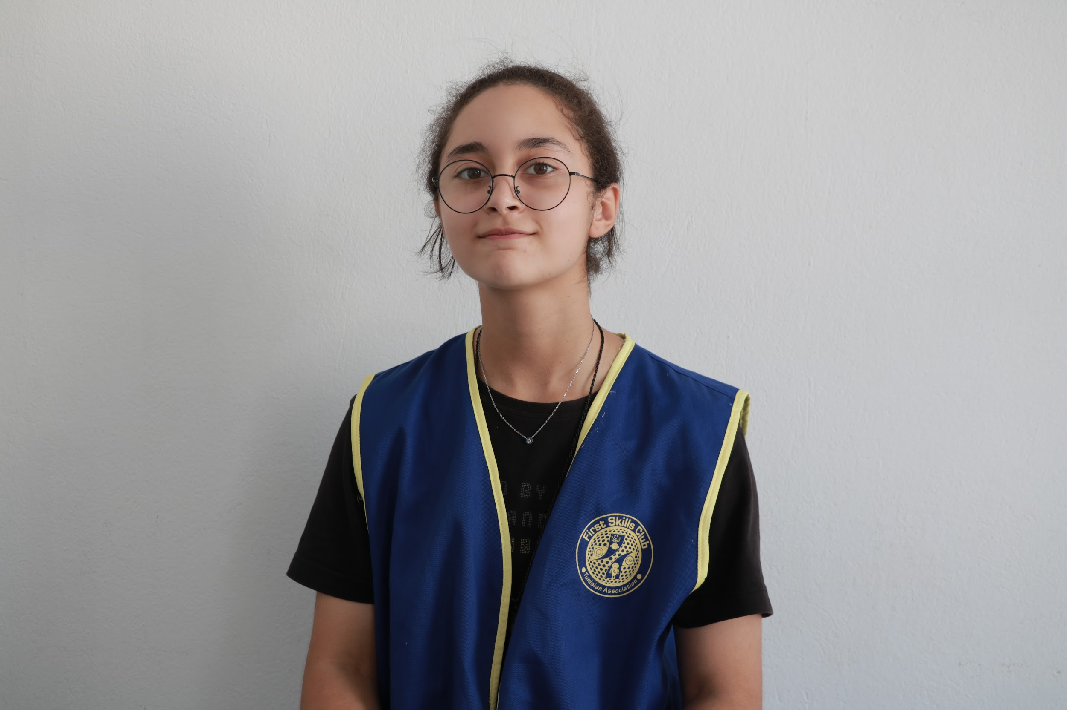
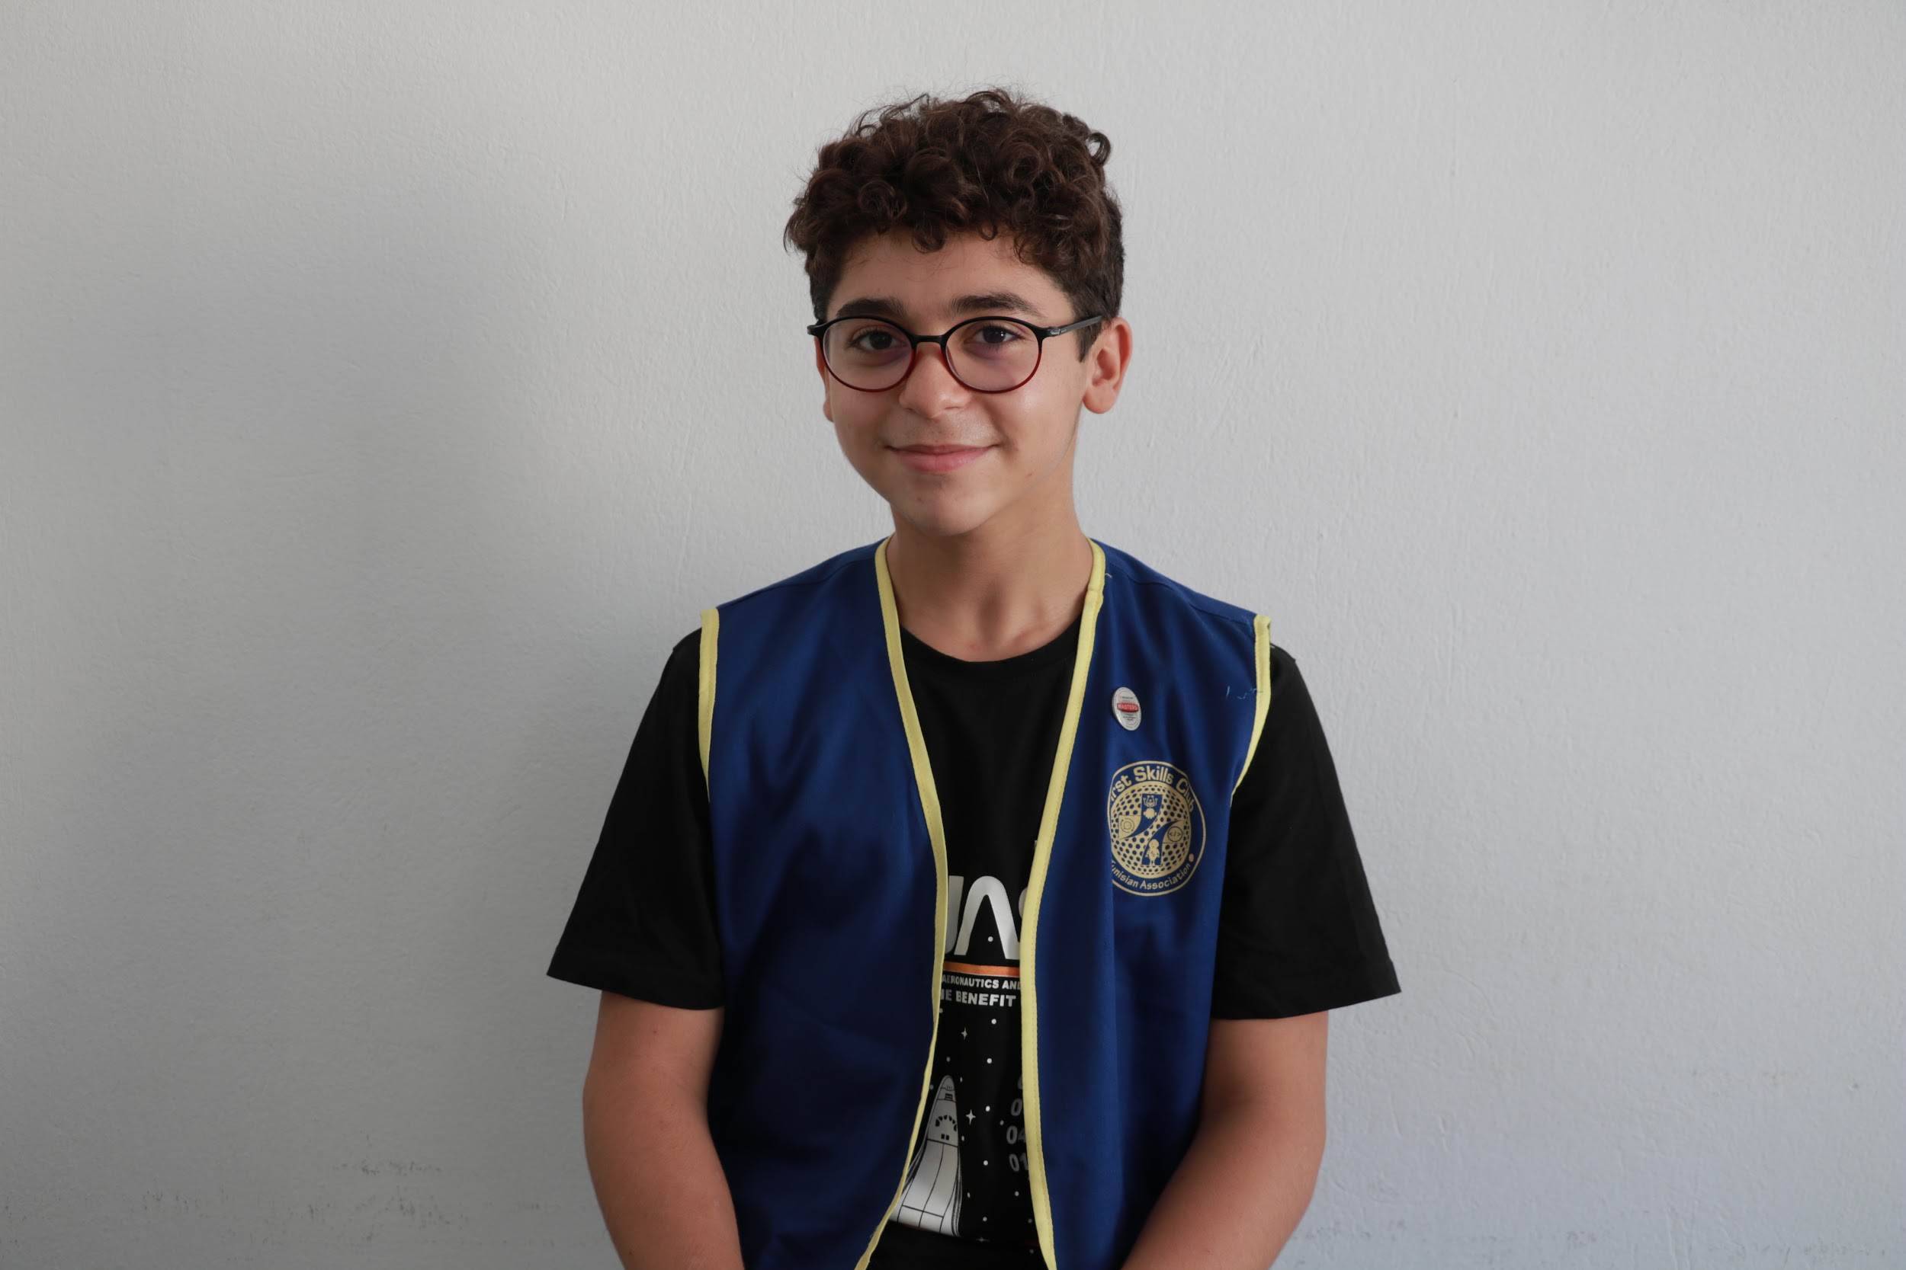
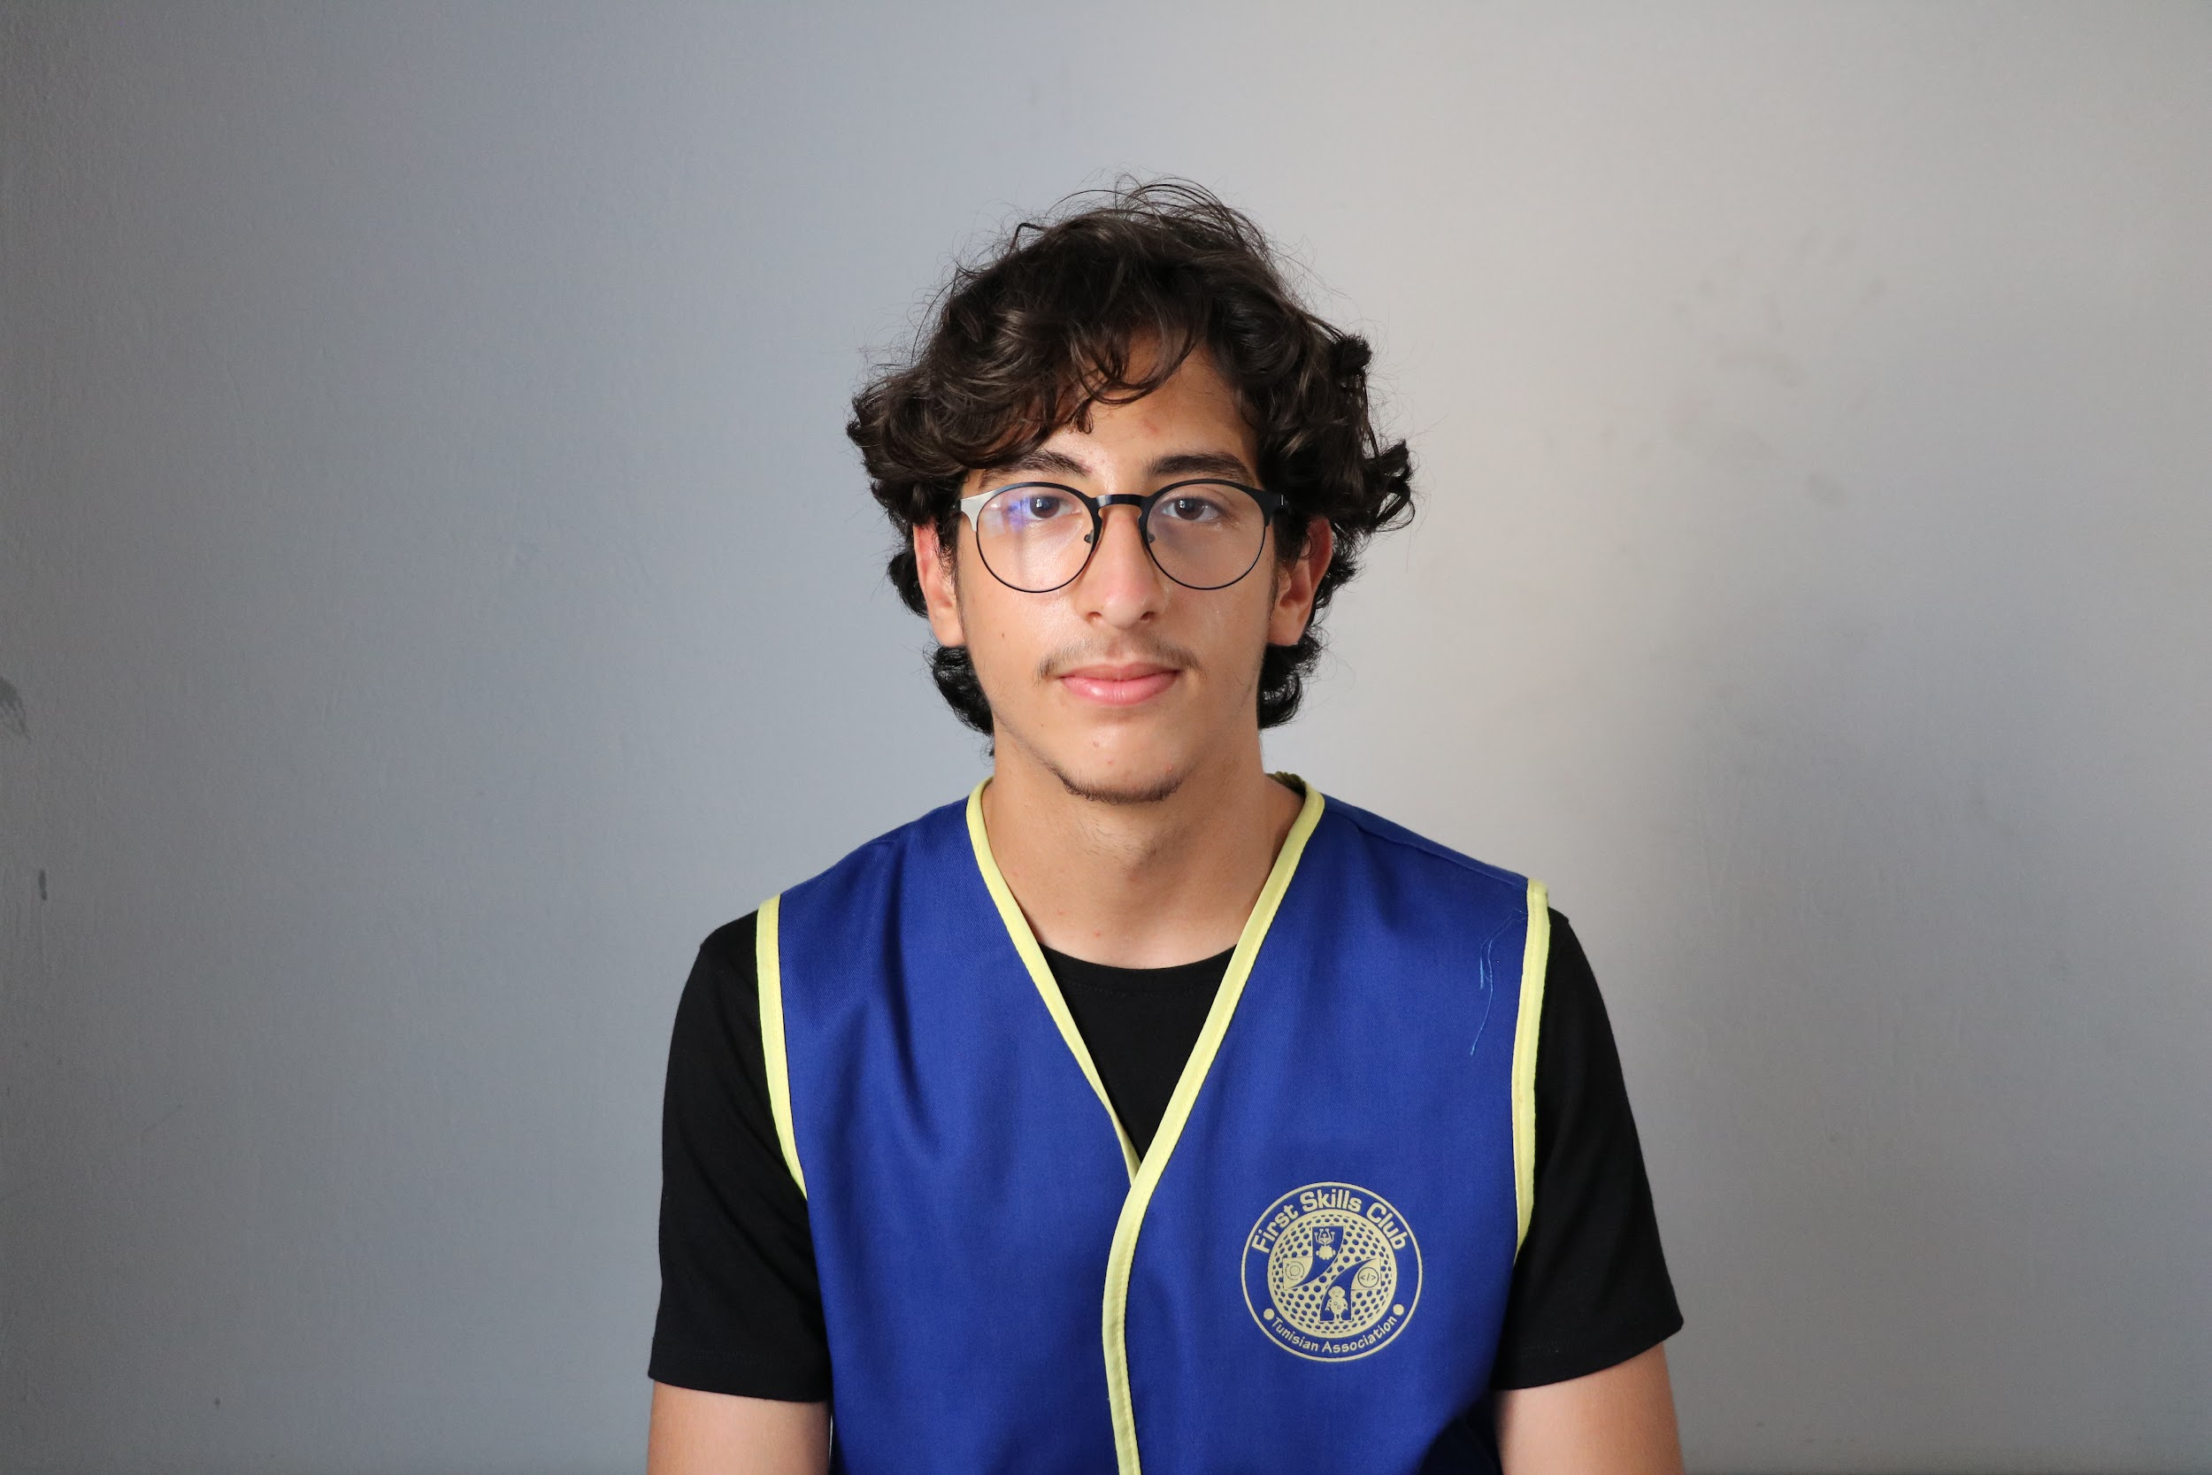
E Lahiani, 15
Engineering Notebook Writer
Head of the Intake Mechanism Sub-team
Yasmine Kharrat, 16
Head of the Drivetrain Mechanism Sub-team
Mohamed Hedi Ben Jmeaa, 15
Head of the Laboratory Mechanism Sub-team
Ahmed Abdennadher, 14
Team Coordinator
And we are…

Slide 3
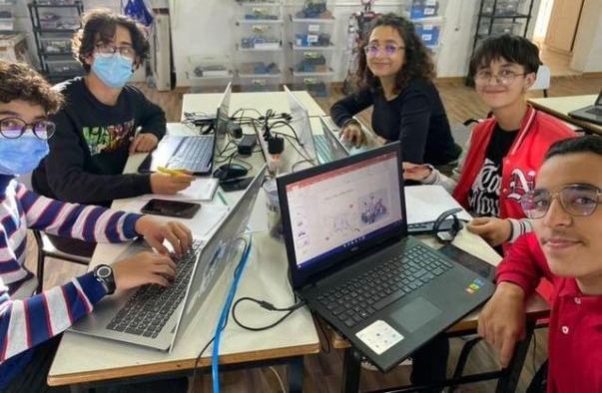
Team ARES!

Slide 4
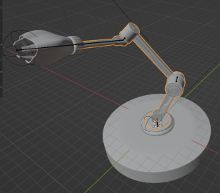
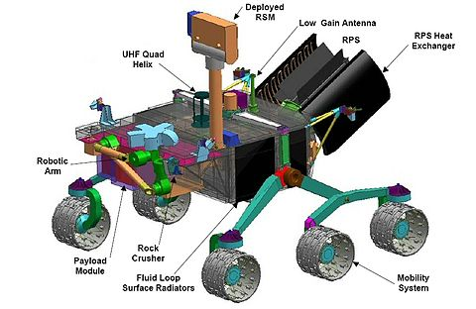
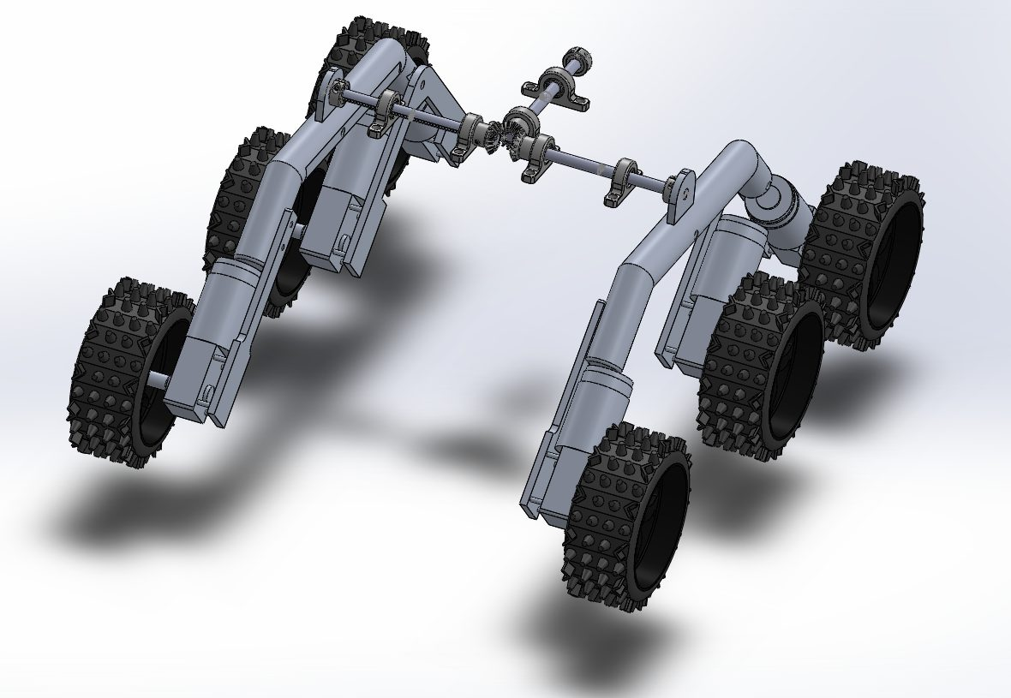
Intake:
Intake Research Paper: Intake Arm Research Paper
Drivetrain:
Drivetrain Research Paper: Drivetrain-Progress.docx
Laboratory:
Laboratory Research Paper: mass spectrometery

Slide 5
Our conclusions…

Slide 6
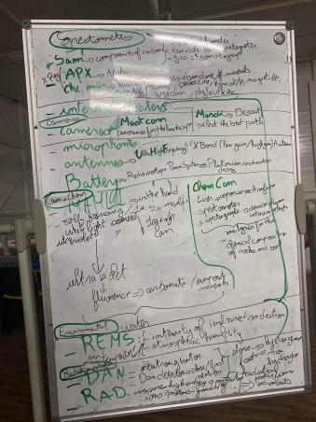
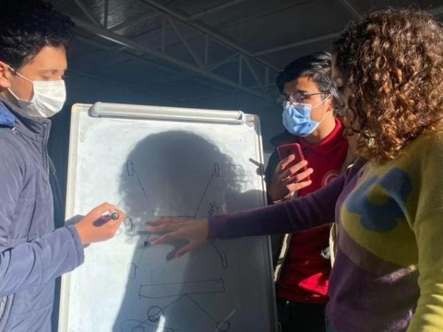
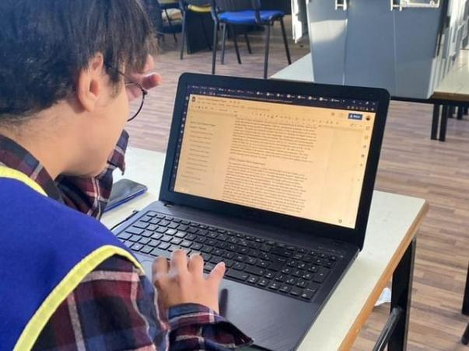
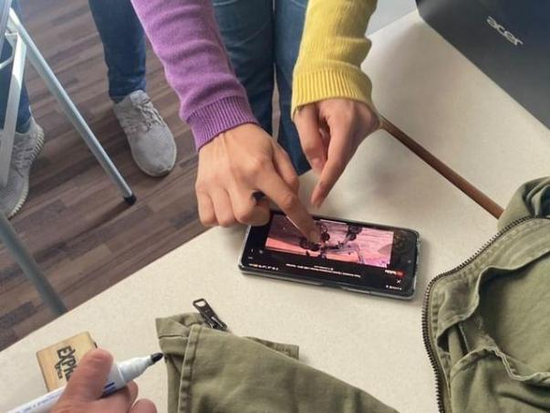
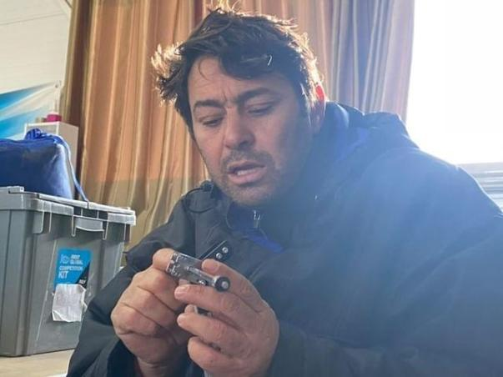
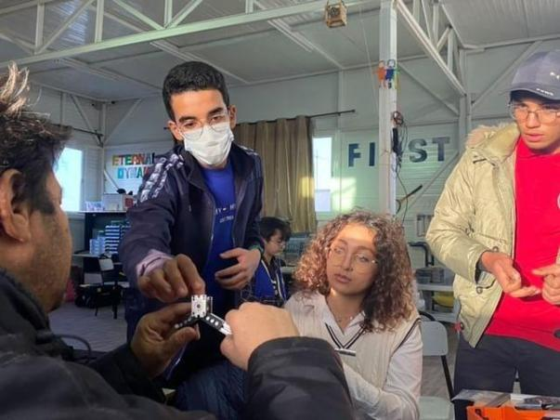
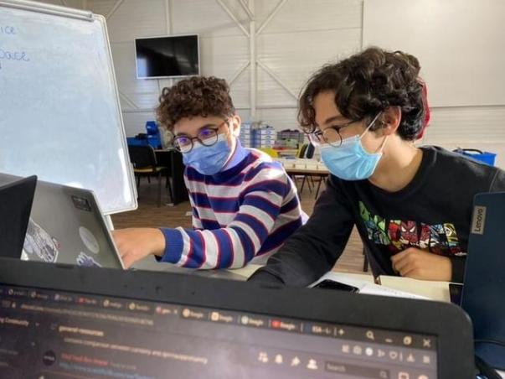
Pics of our Meets!

Slide 7
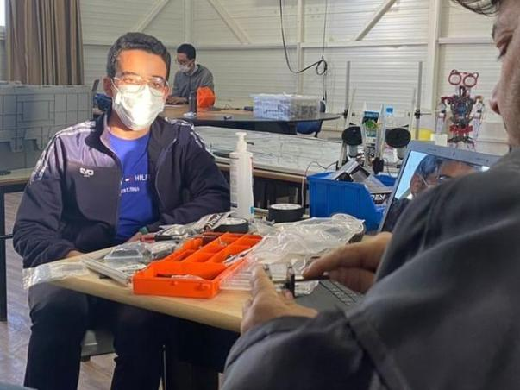
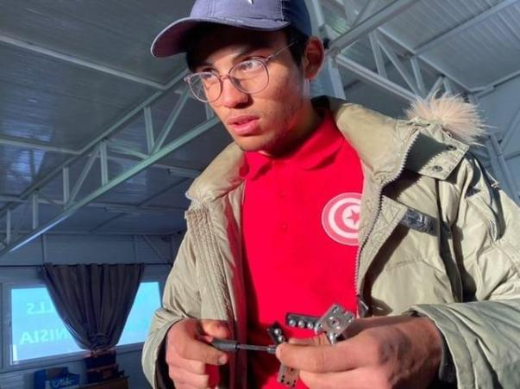
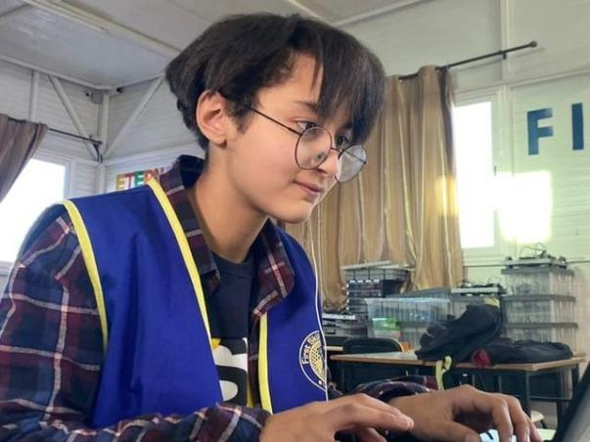
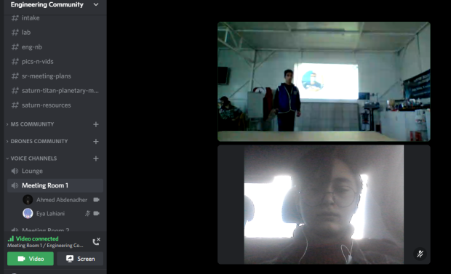
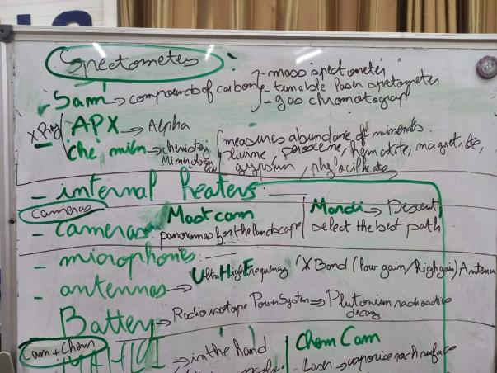
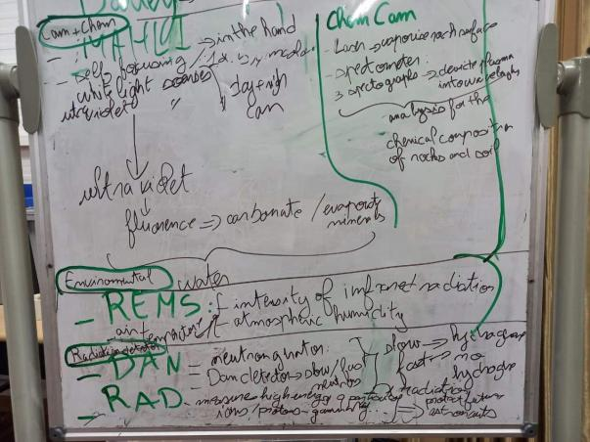
Our meeting gallery

Slide 8
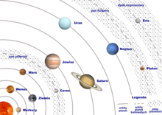
Thank you for your attention.

